Slide 1


MIMIC Healthcare Project

Slide 2

Problem Statement:
Healthcare organizations need a data-driven insights to improve patient care quality, optimize resource allocation, reduce costs, and enhance overall operational efficiency.
Access to comprehensive and de-identified electronic health records (EHR) data, such as the MIMIC database can address this challenge by enabling healthcare professionals and researchers to gain insights and develop data-driven solutions.

Slide 3
Use cases ( End User : Healthcare Provider)
Comparison of admission by gender
Comparison of Male death vs female death
Admission location/department and Discharge location/department statistics
Age Group admissions
No of patients got discharged and not admitted again = No Readmissions
No of patients admitted under each category
Insurance category
Medication prescribed for each diagnosis
Patient admitted with Severity and Mortality High has been Recovered

Slide 4
Business need ( End User : Healthcare Provider)
Comparison of admission by gender
Identifying gender-specific needs to improve overall patient care.
Comparison of Male death vs female death
Analyze mortality rates by gender to identify potential gender-specific health issues or disparities in healthcare outcomes
Admission location/department and Discharge location/department statistics
Identifying busy departments and patient flow management. This information can guide staffing decisions, resource allocation, and facility planning.
Age Group admissions
This analysis can influence preventive care strategies and specialized services for specific age demographics

Slide 5
Business need ( End User : Healthcare Provider)
No of patients admitted under each category
Helps to optimize healthcare services, resource allocation, and patient care strategies.
Insurance category
To optimize billing processes
Medication prescribed for each diagnosis
Link medications to specific diagnoses to improve treatment efficacy, minimize medication errors, and optimize drug inventory and supply chain management
Patient admitted with Severity and Mortality High has been Recovered/Demise
Identify factors influencing patient recovery or mortality, aiding in proactive interventions, care planning, and risk management.

Slide 6
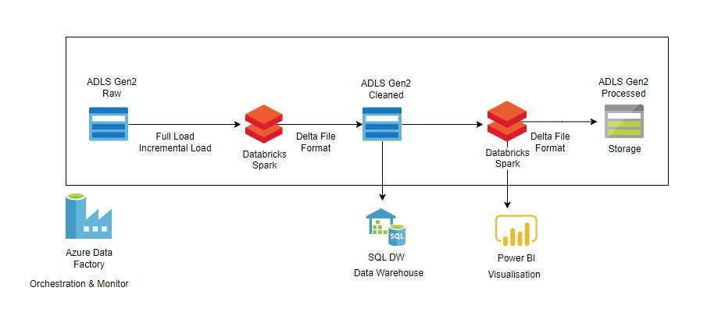
Architecture

Slide 7
Datasets
Internet Links:
Modules | MIMIC (mit.edu)
https://physionet.org/content/mimic-iv-demo/2.2/

Slide 8
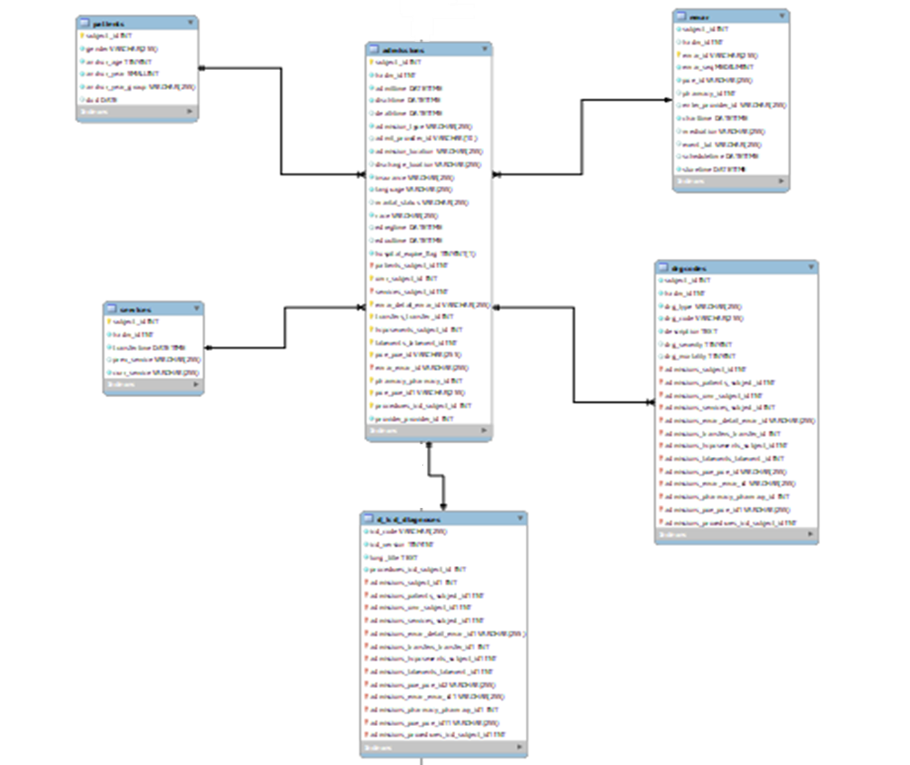
Data Model:

Slide 9
Tools used
Storage
Azure Data Lake(ADLS Gen 2)
Processing
Azure Databricks
Orchestration
Azure Data Factory
Visualisation
Power BI
Monitoring
Azure Data Factory Alerts and Monitor

Slide 10
Future enhancements
Automate the whole pipeline
Parametrize the file path

Slide 11
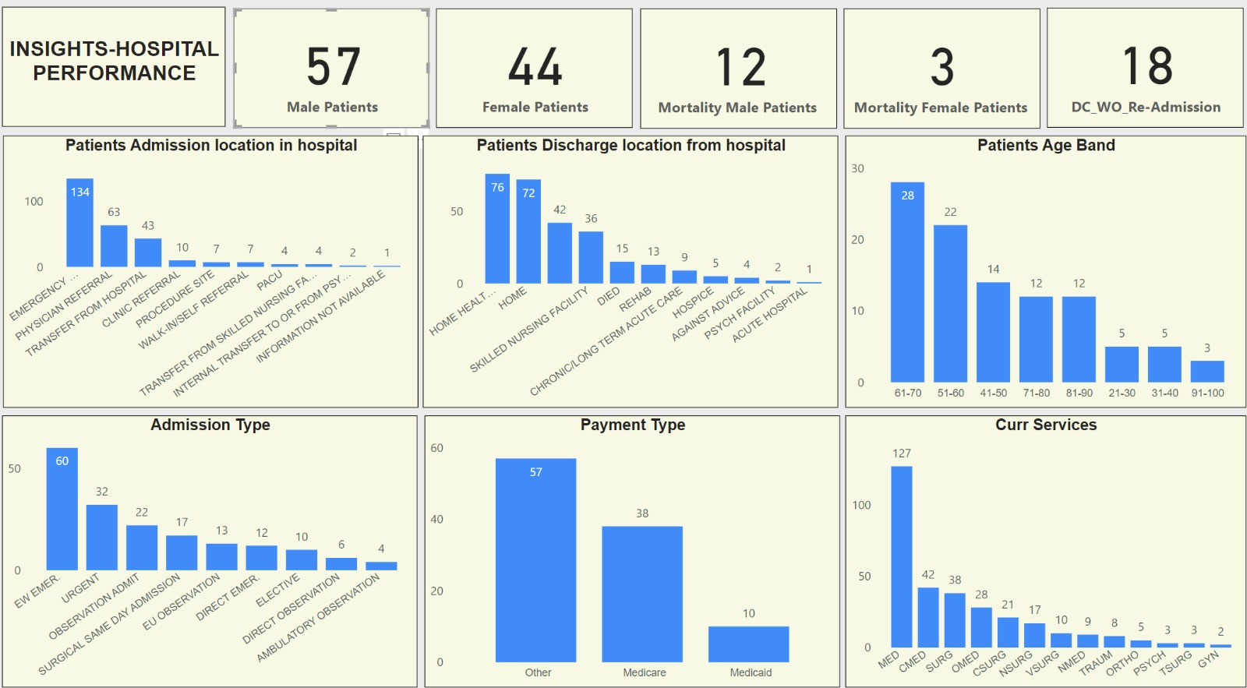
Use case visualization

